Slide 1
Module 9 Guided Lab - Creating a Highly Available Environment
Made for Professor Lanham A. by Amrit Singh

Slide 2
AGENDA
Accessing the AWS management console
Task 1 : Inspecting your VPC
Task 2: Creating an Application Load Balancer
Task 3: Creating an Auto Scaling group
Task 4: Updating security groups
Task 5: Testing the application
Task 6: Testing high availability
Optional task 1: Making the database highly available
Optional task 2: Configuring a highly available NAT gateway

Slide 3
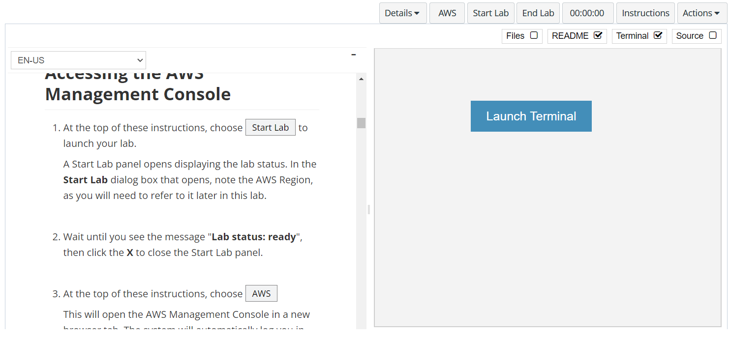
In aws labs click on start lab

Slide 4
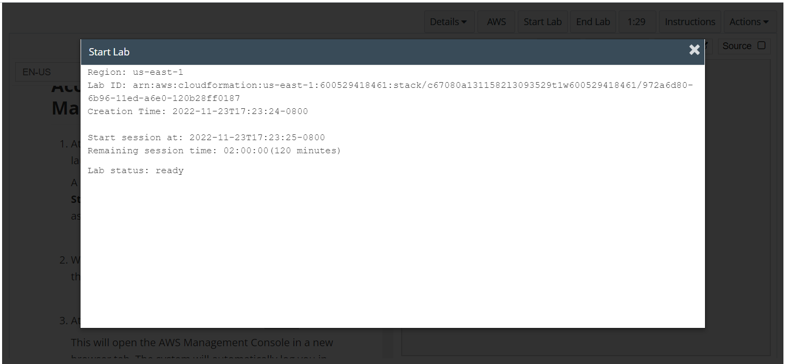
Wait to see lab ready status in the window then press x and click on aws to launch console

Slide 5
Task 1 : Inspecting your VPC

Slide 6
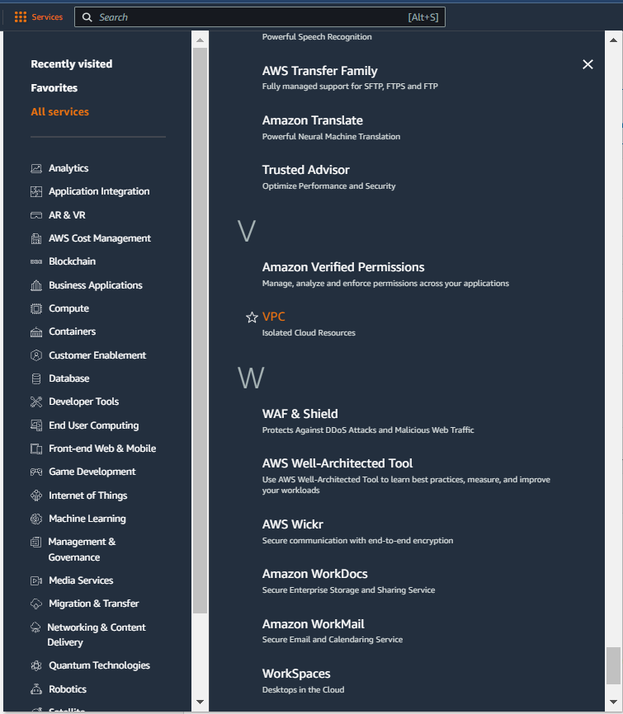
Select services and then click on VPC button
Click on the Services button
Click on the VPC button

Slide 7
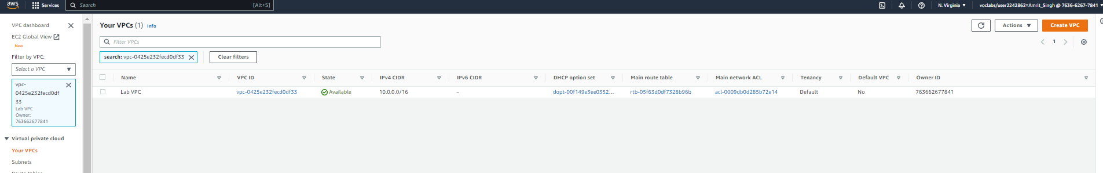
In the vpc navigation pane, select lab vpc in the filter by vpc menu, then click on your vpcs button

Slide 8
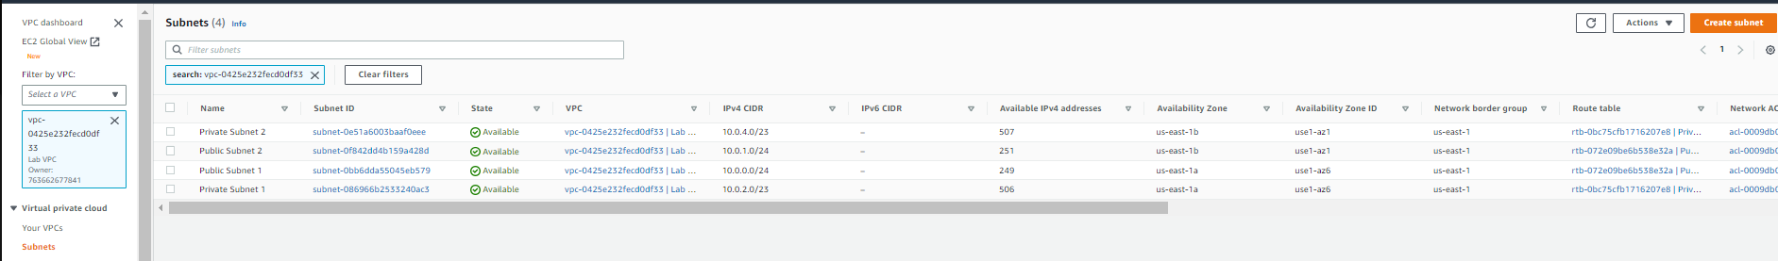
Next click on subnets to view the available subnet config for lab vpc

Slide 9
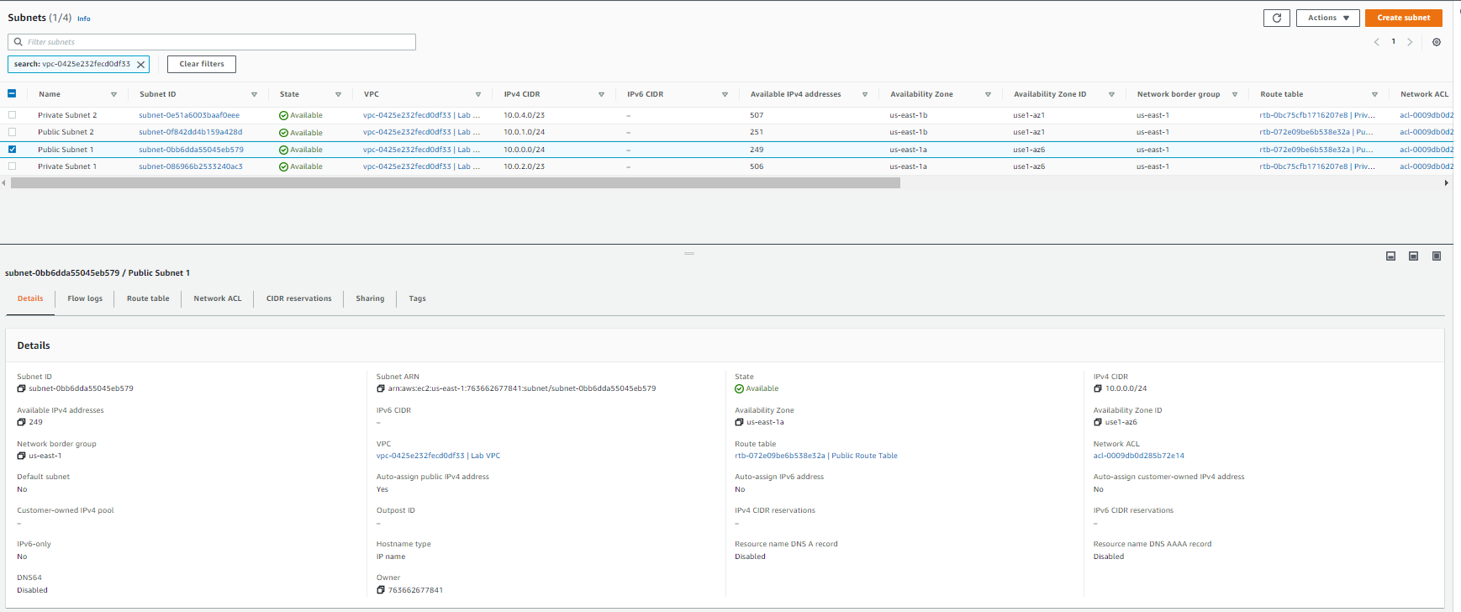
Select public subnet – 1 and then click on details subtab to get additional info about the subnets, similarly, explore for route tables and network acl subtab as well

Slide 10
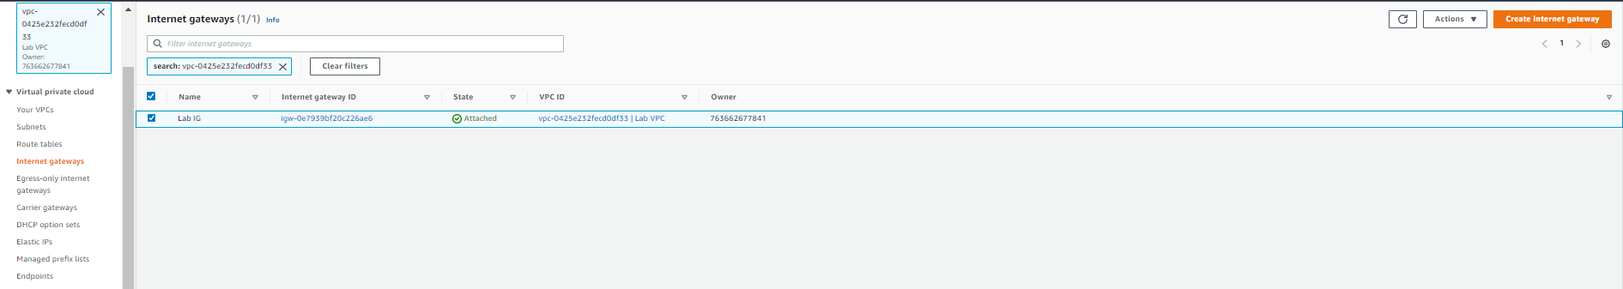
Click on internet gateways in the navigation pane to see the details for internet gateway

Slide 11
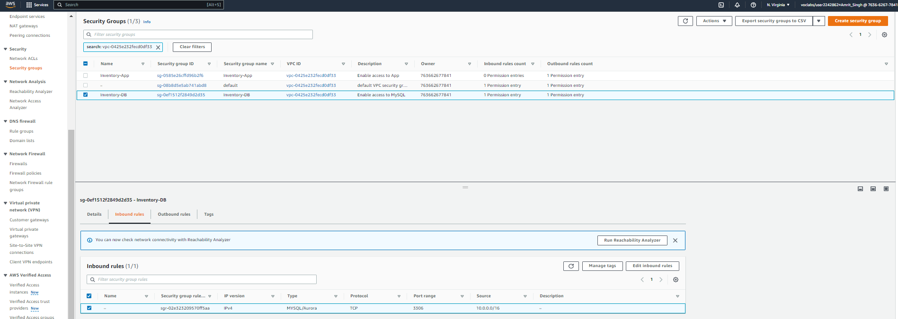
Click on security groups and select inventory-db to view the inbound and outbound rules associated with inventory-db

Slide 12
Task 2 : Creating an Application Load Balancer

Slide 13
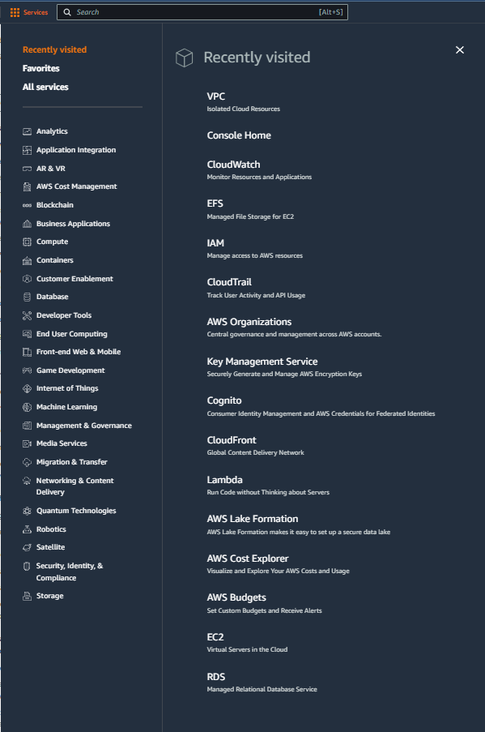
Select services and then click on EC2 button
Click on the Services button
Click on the EC2 button

Slide 14
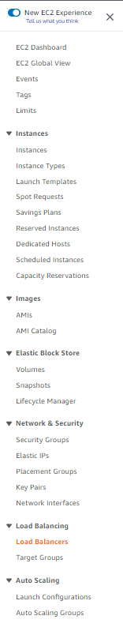
Click on load balancers in the navigation pane
Click on load balancers

Slide 15
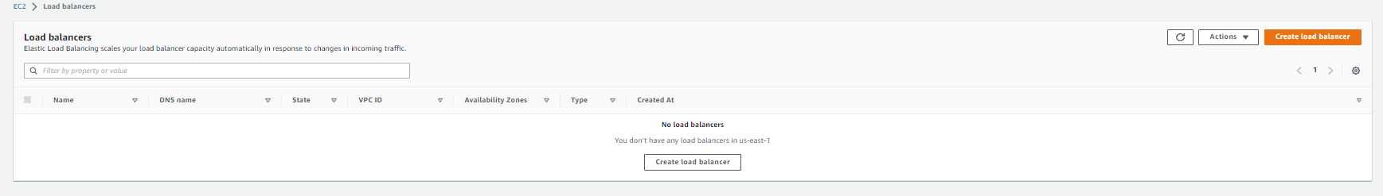
Click on create load balancer

Slide 16
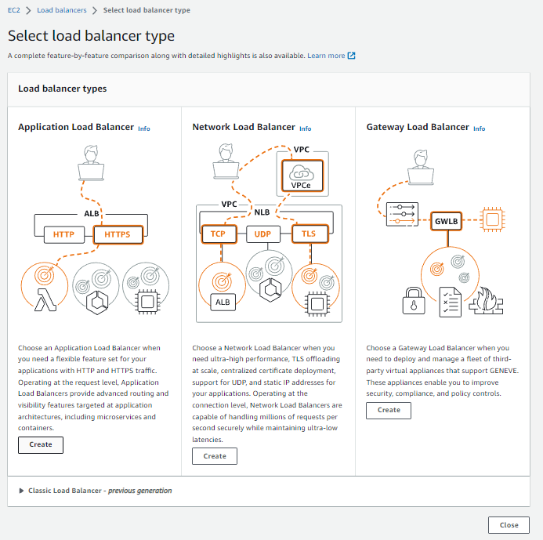
Click on create under application load balancer

Slide 17
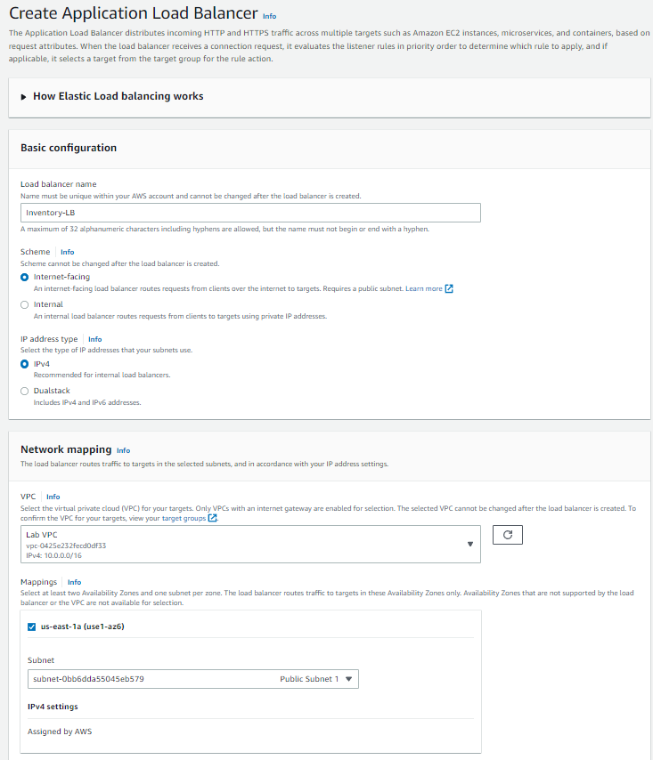
Configure the load balancer with the details shown in aws labs

Slide 18
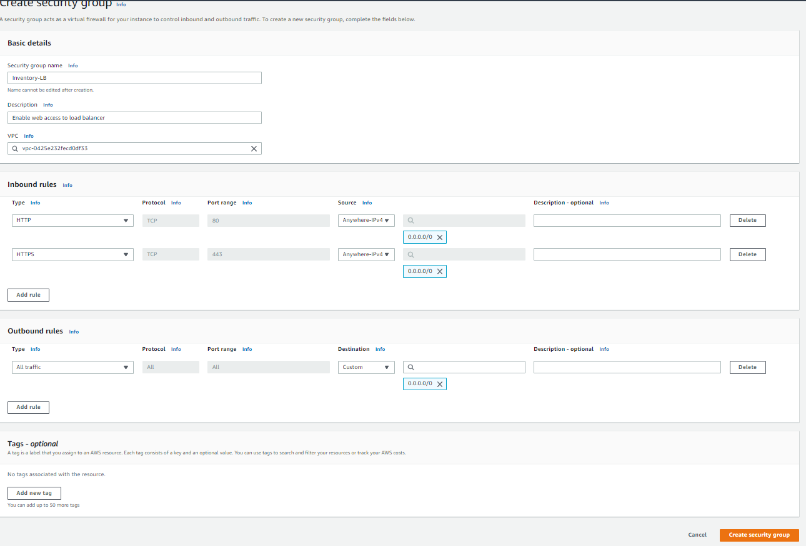
Click on create security groups to open a new tab and update the details as mentioned in labs and shown below, click create security groups

Slide 19
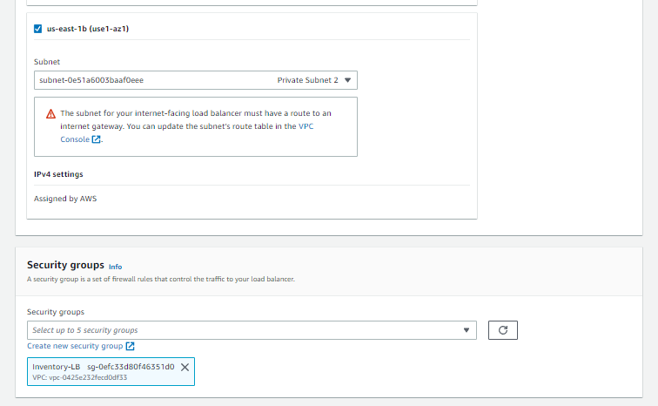
Hit the refresh icon (highlighted in orange) and then select inventory-lb and delete the default security group in the load balancer configuration page

Slide 20
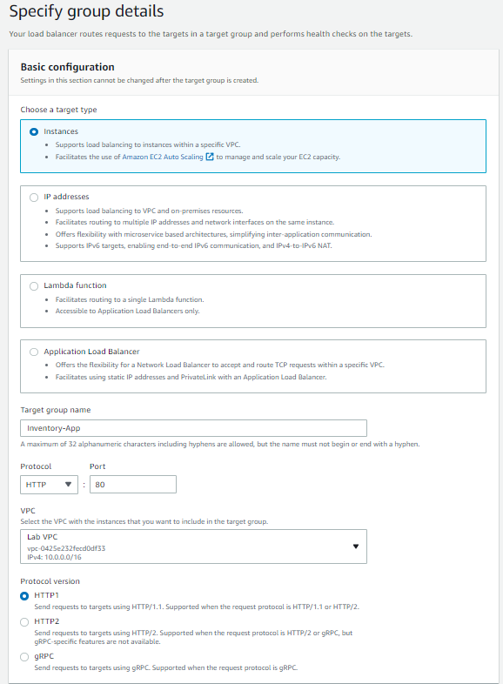
Under the listners and routing click on create target group and configure the details as shown below and in aws labs

Slide 21
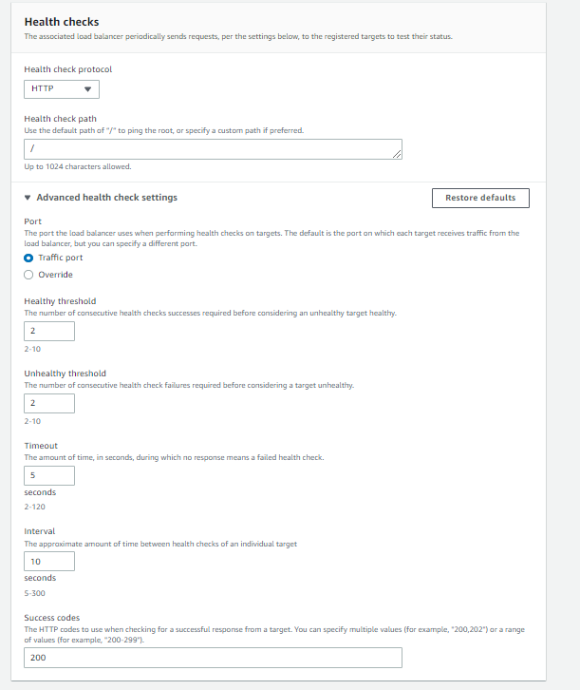
Expand the advanced health check settings and update the healthy threshold and interval as mentioned in the aws labs, then click next, click create target groups

Slide 22
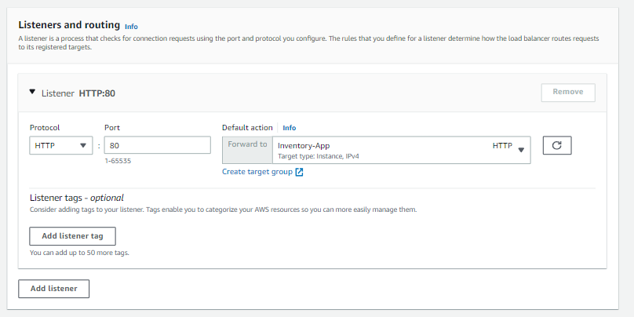
Back in the load balancer settings page, click on refresh in the listner and routing section and then select default action as forward to inventory-app and then click create load balancer

Slide 23
Task 3 : Creating an Auto Scaling group

Slide 24
Select services and then click on EC2 button
Click on the Services button
Click on the EC2 button

Slide 25
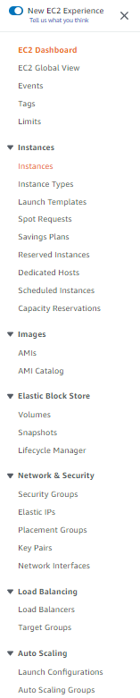
Click on instances in the navigation pane
Click on Instances

Slide 26
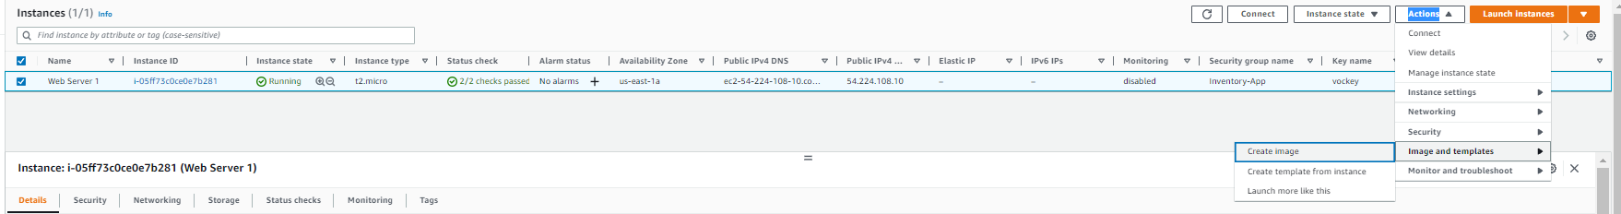
Select web server 1, select actions > images and templates > create image

Slide 27
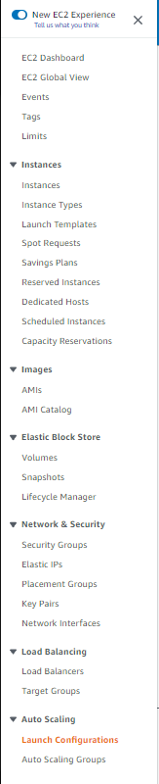
In the navigation pane choose launch configurations

Slide 28
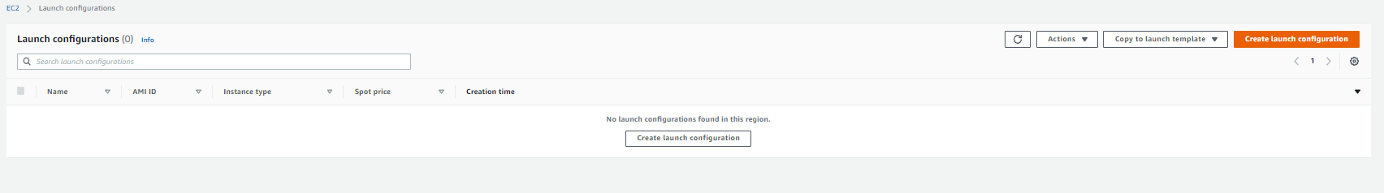
Click on create launch configurations

Slide 29
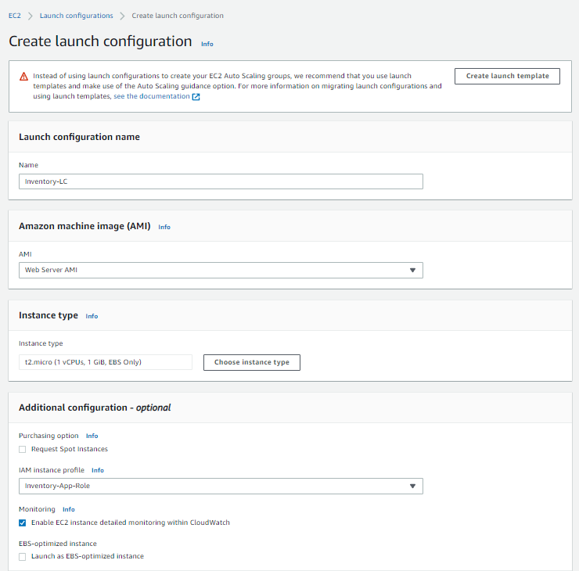
Configure the launch configuration as shown, select t2.micro in case region in us-east-1 by clicking on choose instance types and searching for the instance

Slide 30
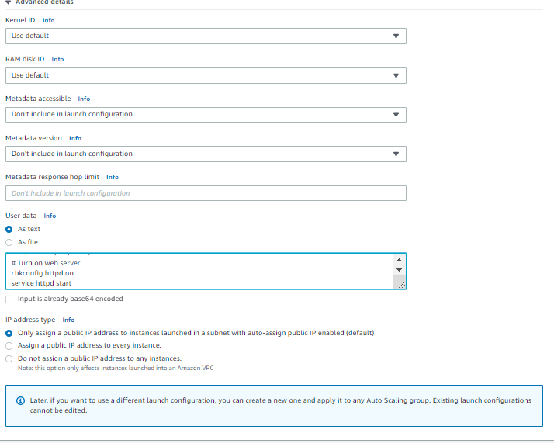
Under advanced details, add the user data as shown in the aws labs

Slide 31
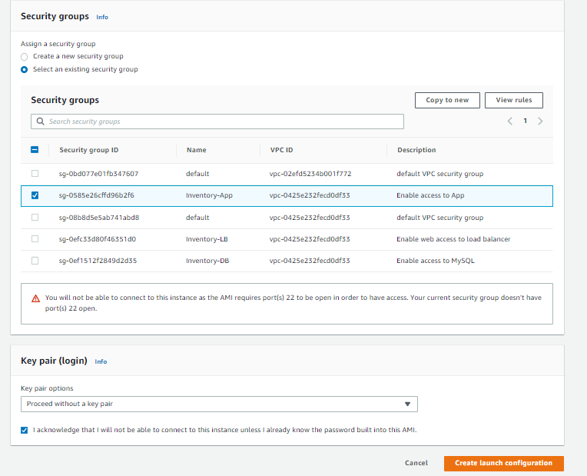
Under security groups choose existing security groups (inventory-app) and proceed without key pair and then click create launch configuration

Slide 32
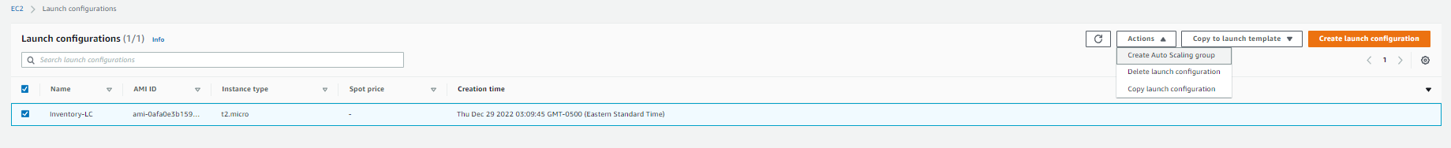
Select inventory-lc > actions > create auto scaling group

Slide 33
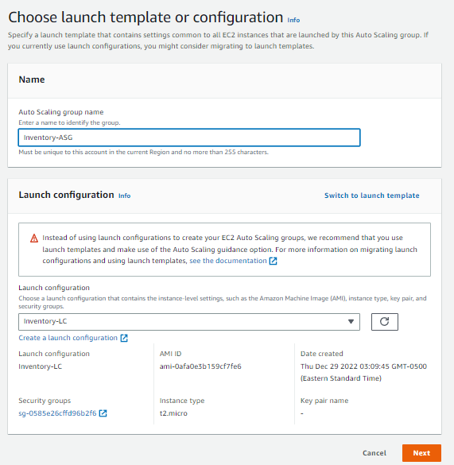
Add the details for launch template as shown and click next

Slide 34
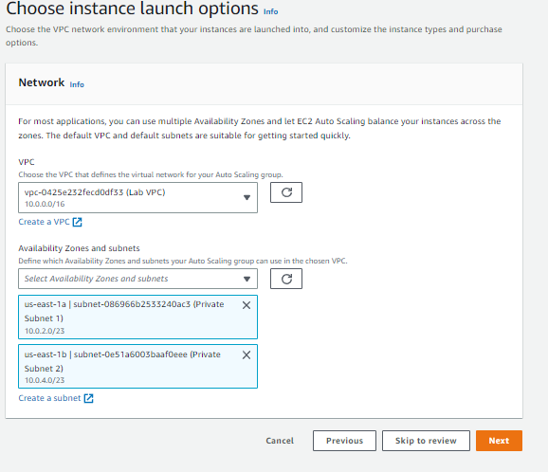
Choose lab vpc and the 2 private subnet, then click next

Slide 35
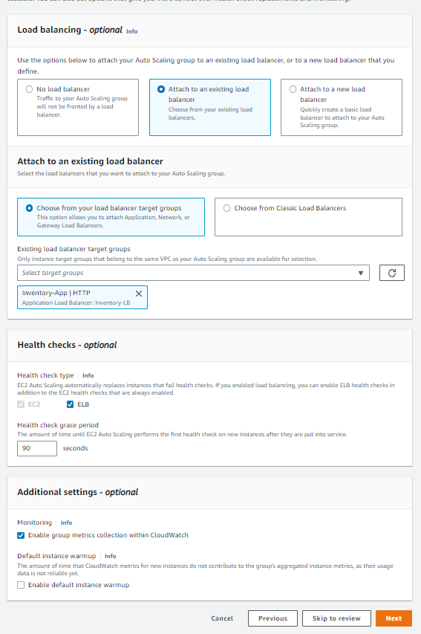
Configure the advanced options as shown in the screenshot/aws labs and click next

Slide 36
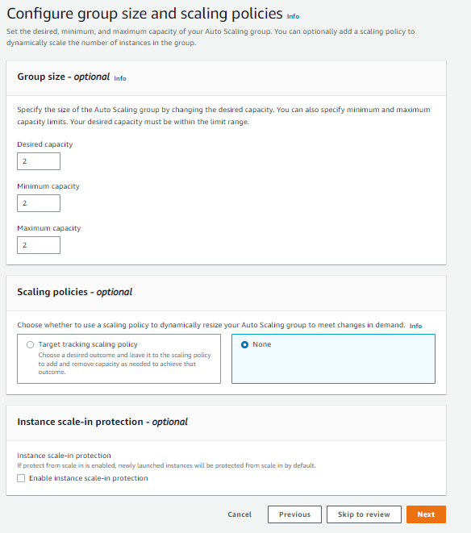
Set the group size and scaling policies as shown/aws labs

Slide 37
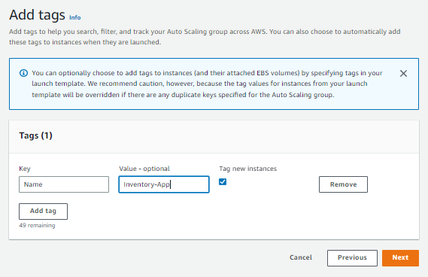
Click next on add notification page, click on add tags in the tags page, then click next, click create auto scaling group button on the next page

Slide 38
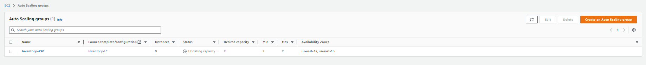
Currently the instances would be 0 but ASG will try to reach 2 instances as the desired capacity

Slide 39
Task 4 : Updating security groups

Slide 40
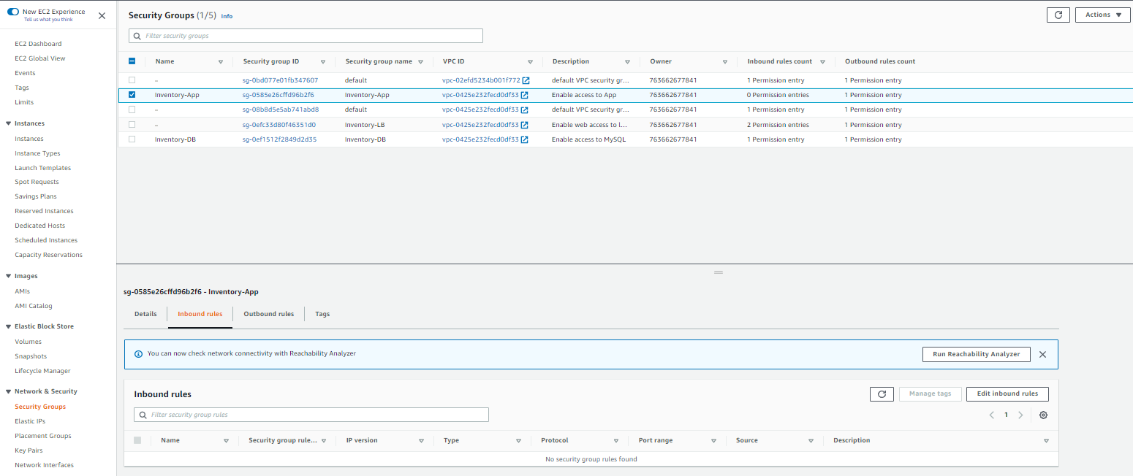
Go to the security groups page from the navigation pane, select inventory-app and go to inbound rules tab and click on edit inbound rules

Slide 41
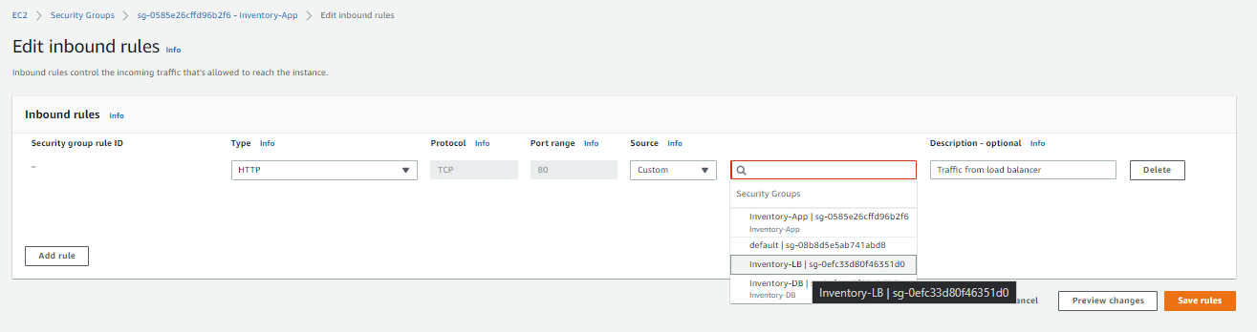
Click on add rules and configure as shown, click on save rules

Slide 42
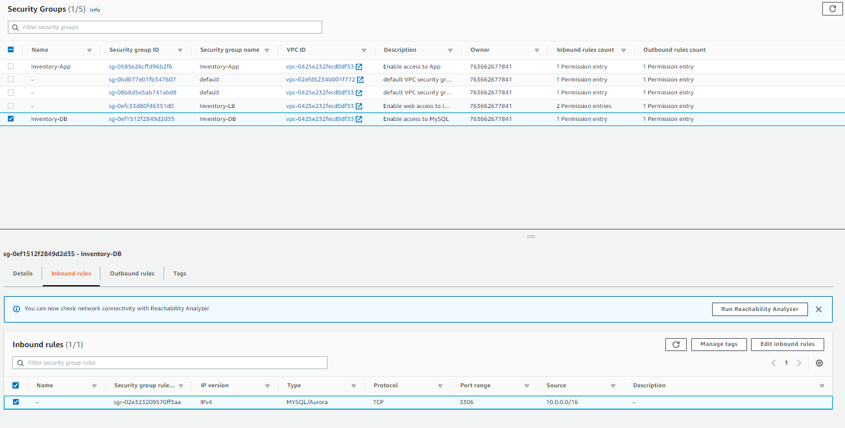
Select inventory-db in the security groups page and edit inbound rules

Slide 43
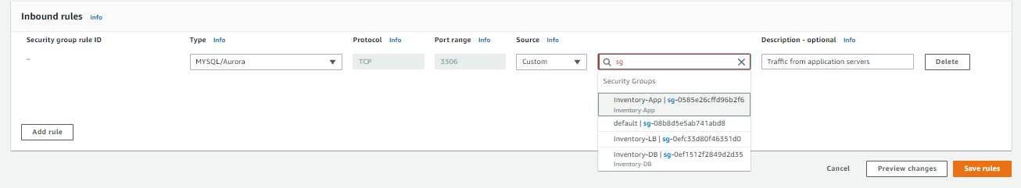
delete any other rule that was present by default, Click on add rules and configure as shown, click on save rules

Slide 44
delete any other rule that was present by default, Click on add rules and configure as shown, click on save rules

Slide 45
Task 5 : Testing the application

Slide 46
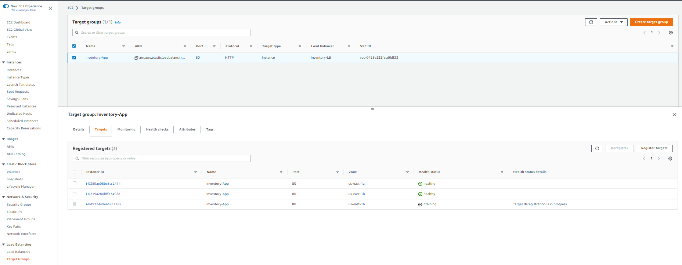
Select target groups in the navigation pane, select inventory-app > targets sub tab, you can see the 2 instances that are healthy

Slide 47
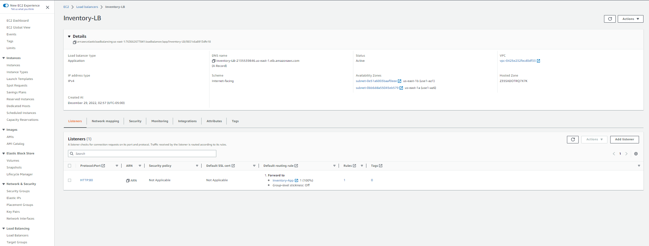
Choose load balancers in the navigation pane, open the details of inventory lab and copy the dns name

Slide 48
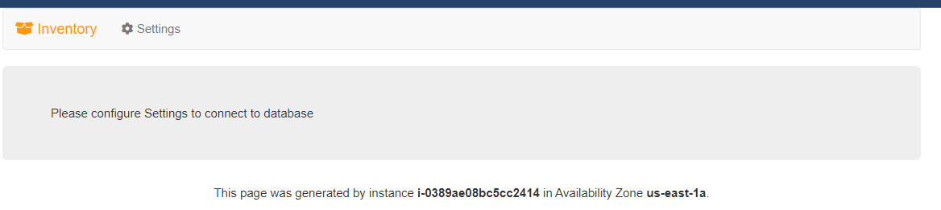
Copy and paste the dns name in a browser to see the following page

Slide 49
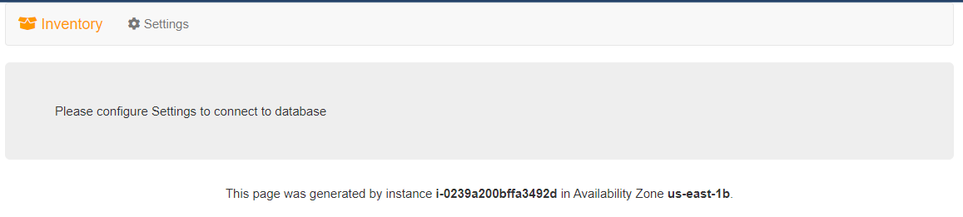
Keep refreshing the page, the instance would change due to 2 instances running

Slide 50
Task 6 : Testing high availability

Slide 51
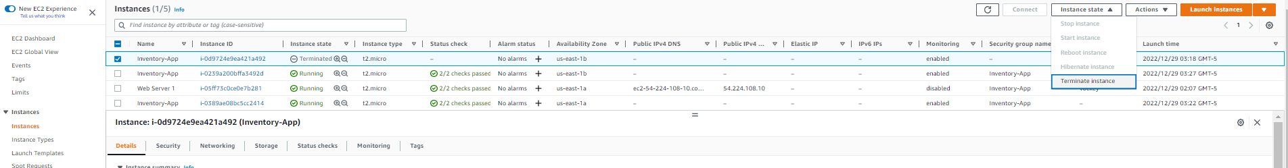
Click on the instances button and then choose inventory-app, click on instance state > terminate instance and click terminate again

Slide 52
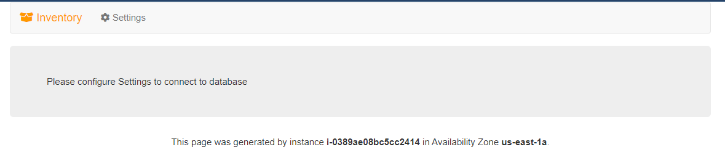
Our application is still up due to 2 instances running but will return only 1 instance and will launch a replacement instance in some time

Slide 53
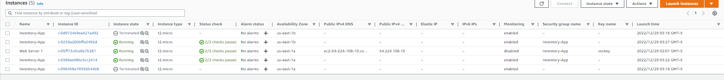
In the instance page in aws, click refresh to see a new inventory-app instance appear

Slide 54
Optional task 1: Making the database highly available

Slide 55
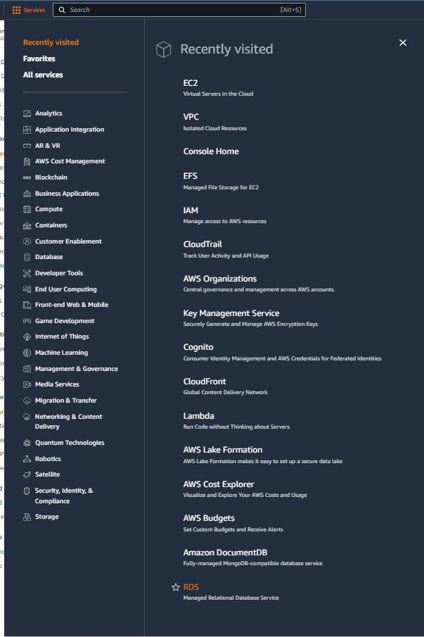
Choose RDS in the services

Slide 56
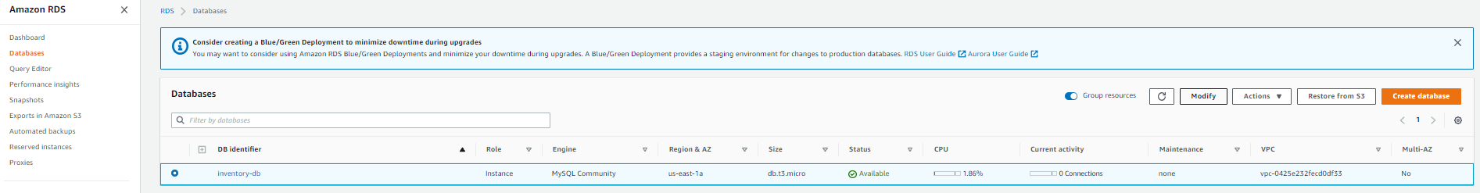
Choose databases in the navigation pane and select inventory-db and click on modify

Slide 57
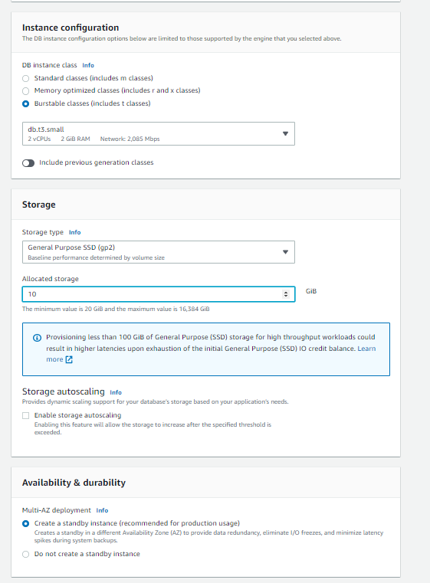
Change the instance configuration, multi-az deployment and storage in the modification menu, then click continue

Slide 58
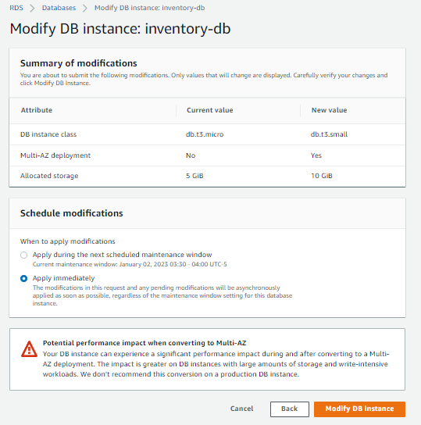
Under scheduling and modifications choose apply immediately and click modify DB instance

Slide 59
Optional task 2: Configuring a highly available NAT gateway

Slide 60
Select services and then click on VPC button
Click on the Services button
Click on the VPC button

Slide 61
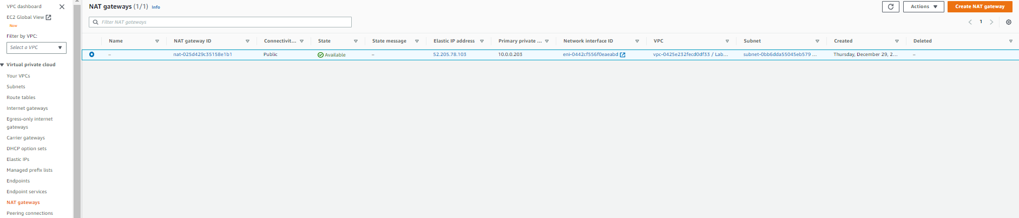
Choose nat gateway in the navigation pane and then click create nat gateway

Slide 62
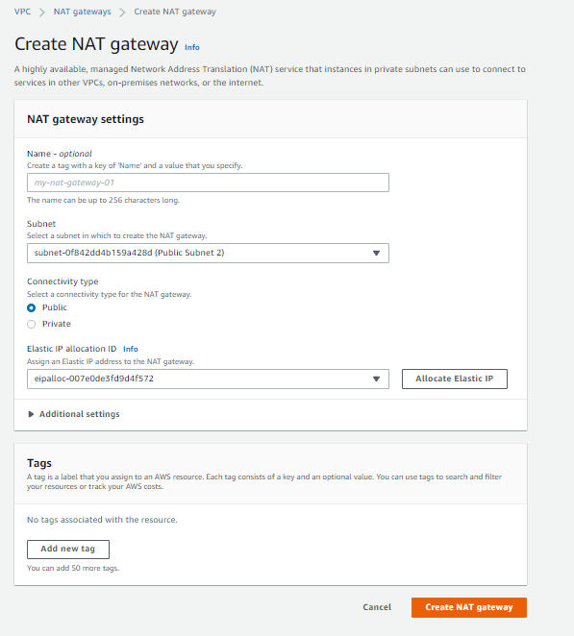
Update the nat gateway settings as shown in the screenshot below / aws labs and then click create nat gateway

Slide 63
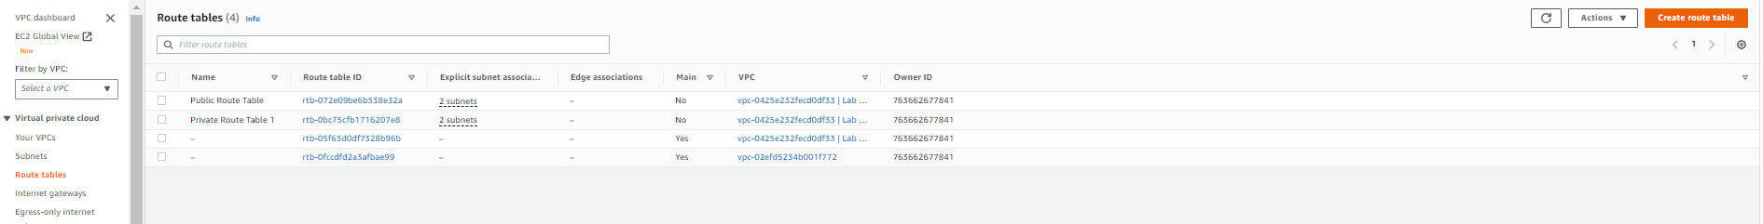
Choose route tables in the navigation pane and click on create route table

Slide 64

Configure the create route table settings as shown below and click on create route table

Slide 65

Click on edit routes under private route table 2

Slide 66
Click on add route and select the nat gateway that we did not previously configure (follow steps in aws labs)

Slide 67

Under the subnet association subtab click on edit subnet association and select private subnet-2 and click save associations

Slide 68
THANK YOU
Amrit Singh

